Slide 1



Major Project
1010043492
Data Analysis and Performance Insights of a Web Development Company
Name : Prajapati Shyam K.
Enrollment No: 2201031000102
Branch: B.Tech(IT)

Slide 2
Index
Introduction
Background and Motivation
Relevance and Importance
Literature review
Objectives
Required Tools and Technology
Method/ Approach
Screen Shots
Bibliography

Slide 3
Introduction
• This project focuses on analyzing internal project data of a Web Development Company. • The aim is to extract meaningful business insights.

Slide 4
Background and Motivation
In today’s digital world, web development companies generate large volumes of data from websites, applications, and user interactions. Analyzing this data is essential to understand customer behavior, improve performance, and support business growth.
During my Data Analysis internship, I worked with real company datasets to clean, analyze, and visualize data using tools like Excel, Python, and Power BI.
The main motivation behind this internship is to gain practical industry experience, enhance analytical skills, and apply theoretical IT knowledge to real-world business problems while building a strong foundation for a career in Data Analytics.

Slide 5
Relevance and Importance
• Helps management understand revenue trends. • Identifies high-performing services. • Improves strategic planning. • Supports data-driven decision making.

Slide 6
Literature review
Previous studies show that data analysis plays an important role in business decision-making. Researchers have highlighted that tools like Microsoft Power BI and Tableau help transform raw data into meaningful insights through dashboards and reports.
Literature also suggests that analyzing customer behavior, sales trends, and website performance improves business strategies and operational efficiency. This project applies these data analysis concepts to real company data to generate useful insights.

Slide 7
objectives
To identify patterns and trends in client requirements and project types handled by the web development company.
To analyze the relationship between project complexity, development time, and delivery performance.
To evaluate the effectiveness of different technologies and frameworks used in web development projects.
To perform comparative analysis of completed and ongoing projects.
To support strategic planning by providing actionable insights from historical data.
To enhance reporting accuracy through automated dashboards and visual analytics.

Slide 8
Required Tools and Technology
• Python (Jupyter Notebook) • Pandas Library • Power BI Desktop • CSV Dataset • Basic DAX Functions

Slide 9
Method/ Approach
1: Data Collection (Company Dataset) 2: Data Cleaning in Jupyter Notebook 3: Exploratory Data Analysis 4: Import Data into Power BI 5: Create DAX Measures (Total Revenue) 6: Build Dashboard Visualizations 7: Analyze Insights

Slide 10
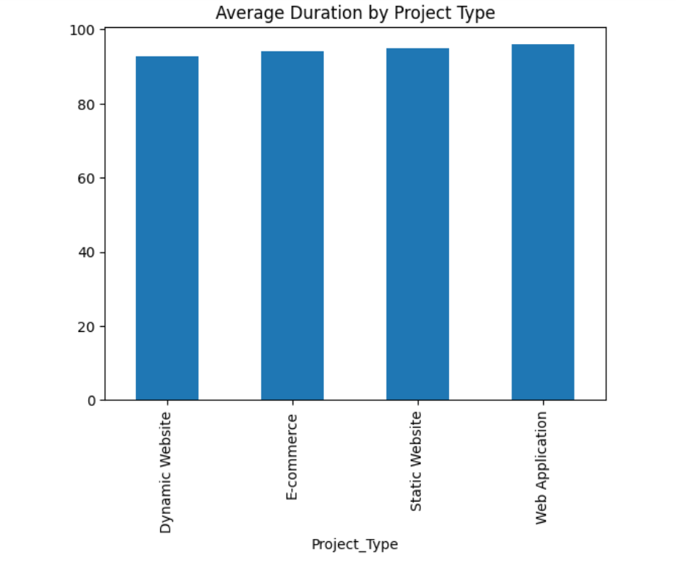
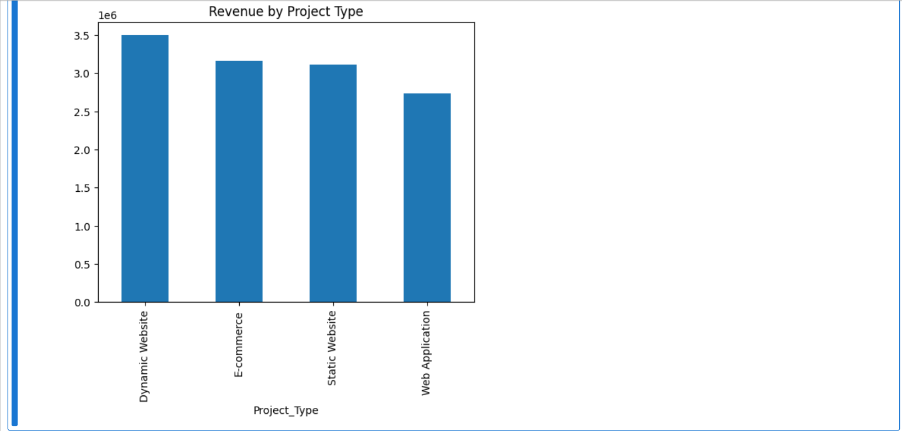
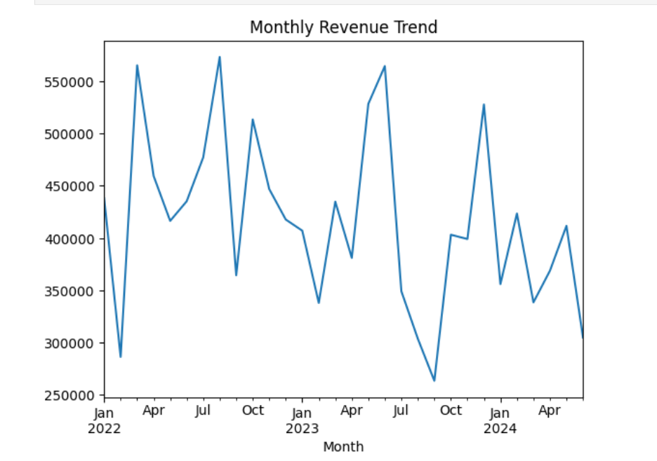
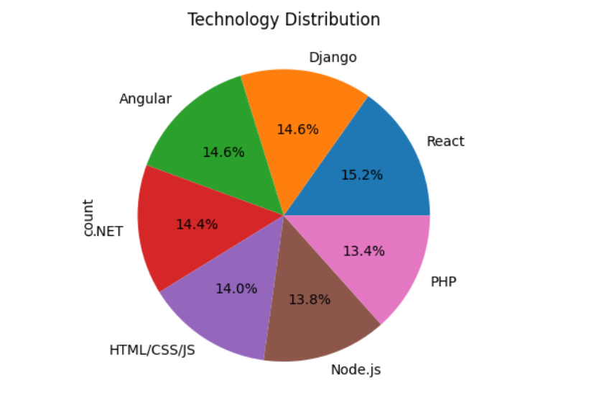
Screen shots
Screenshot 1
Screenshot 2
Screenshot 3
Screenshot 4

Slide 11
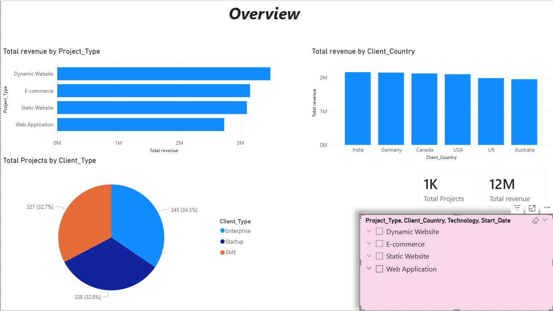
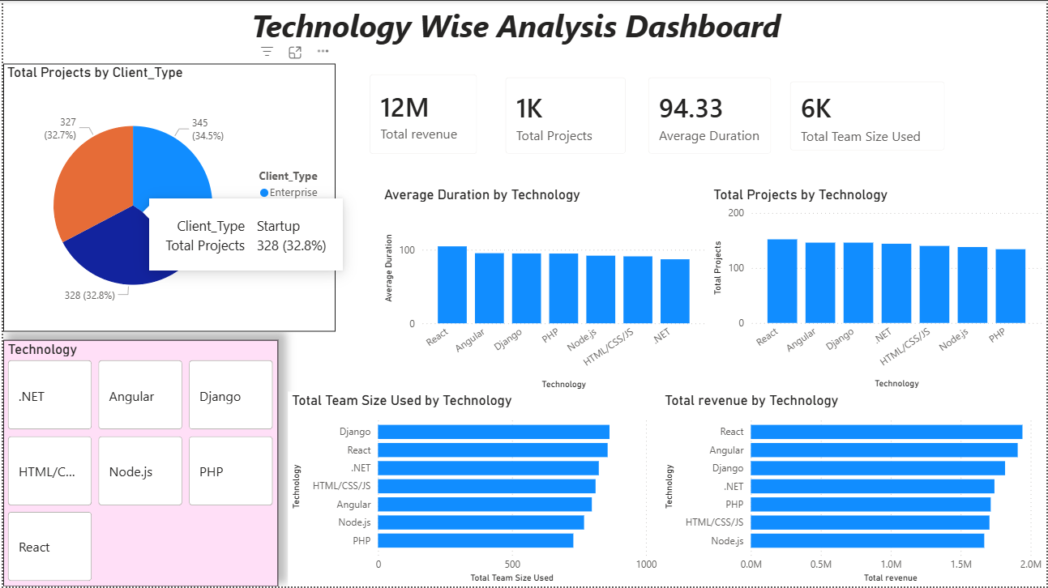
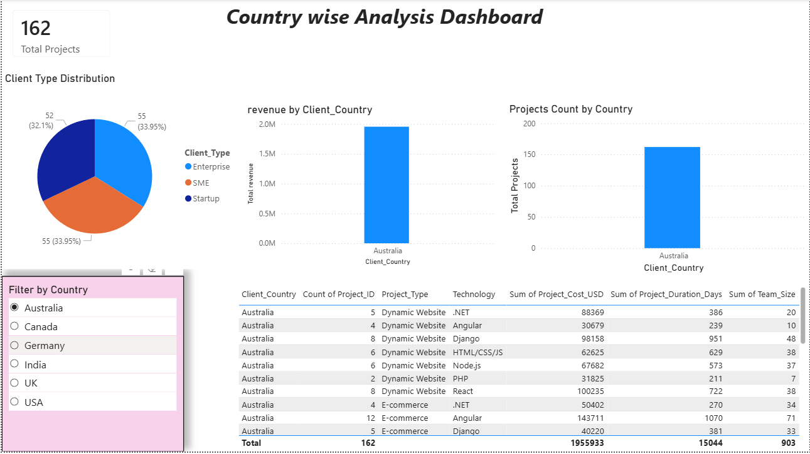
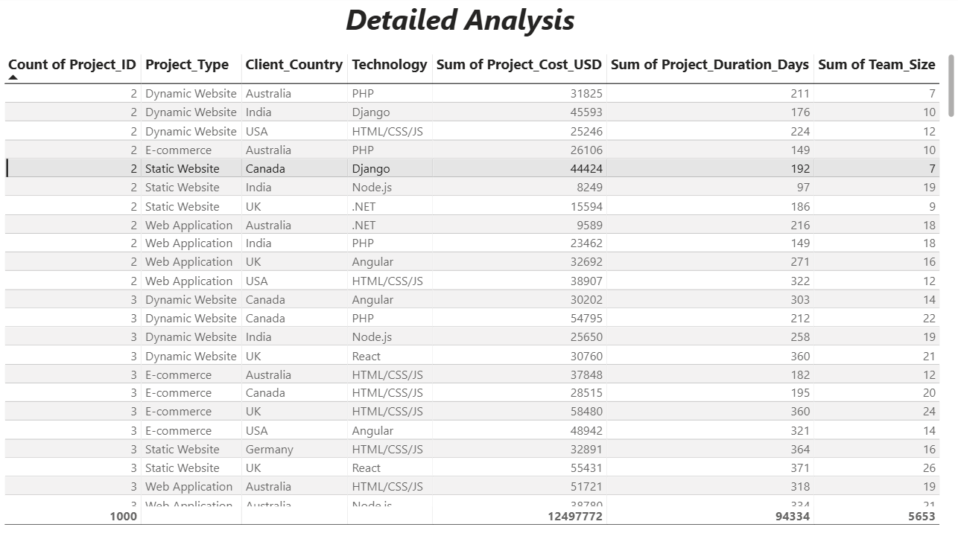
Screenshot 5
Screenshot 6
Screenshot 7
Screenshot 8

Slide 12
Bibliography
[1] Microsoft Power BI Documentation [2] Python Pandas Official Documentation [3] Company Internal Dataset

